Slide 1

Java how to program
王美红

Slide 2
Contact
2021Java程序设计1班
群号:595316786
2021Java程序设计2班
群号:539472764
教师：
王美红
Tel: 13799286518
Email: wangmh@xmu.edu.cn
Office：行政楼A305B
教学助理：
罗斌
Tel：0592-2580399
Email: robin@xmu.edu.cn

Slide 3
Main Reference books
Java How to Program, 11th
Thinking in Java, 4th
Core Java 2 I/II , 7th

Slide 4
Score composed of:
Usually score 20% (homework + experimental score + attendance)
Computer programming Examination 30%
final exam 50%

Slide 5
Pay attention several:
Need overall grasp (OOP language).
It is best to understand the first floor mechanism, but is not merely pauses in the surface layer.
To make, to write the code, but is not holds a book to have a look at the line.
To study some to be more, a more complex knowledge, for instance the J2EE development and so on.

Slide 6
Pay attention several:
KIS (keep it simple)
Read the documentation frequently
Study each error or warning message you get
Read the source code of the Java API classes
Read <Java Code Conventions>

Slide 7
Objectives
To write Java programs that are :
bug-free
clear
more understandable
more maintainable
easy to test and debug

Slide 8
Before you start
Software and other resources needed
The examples in the book
JDK8-JDK13
Eclipse
IntelliJ IDEA
MySQL
MySQL Connector
……

Slide 9
Before you start
Installing the J2SE Development Kit (JDK)
Make sure that JDK and JRE are all installed.
https://www.oracle.com/technetwork/java/javase/overview/index.html

Slide 10
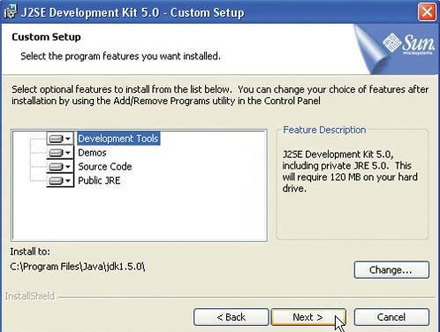
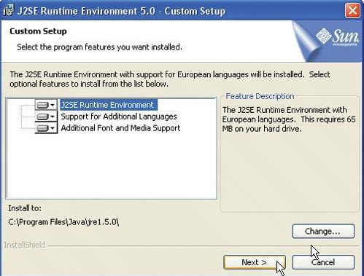
Two important windows

Slide 11
Before you start
Setting the System Variable
Opening the System Properties dialog.
Opening the Environment Variable dialog.
Editing the PATH variable.
Add： ”;Jdk installed directory\jdk**\bin”
Editing or Creating the CLASSPATH variable
Add: ”;Jdk installed directory\jdk**\lib;.”
Test the environment:
type “java –version” at dos command line.

Slide 12
Before you start
Install Eclipse
Open Eclipse
Create a new project
Importing or creating an existing java file and running it.
Install Scene Builder（2.0）.

